Slide 1
Net Sales and GP% Development in Excel

Slide 2
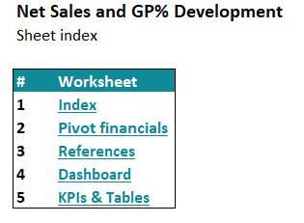
Index

Slide 3
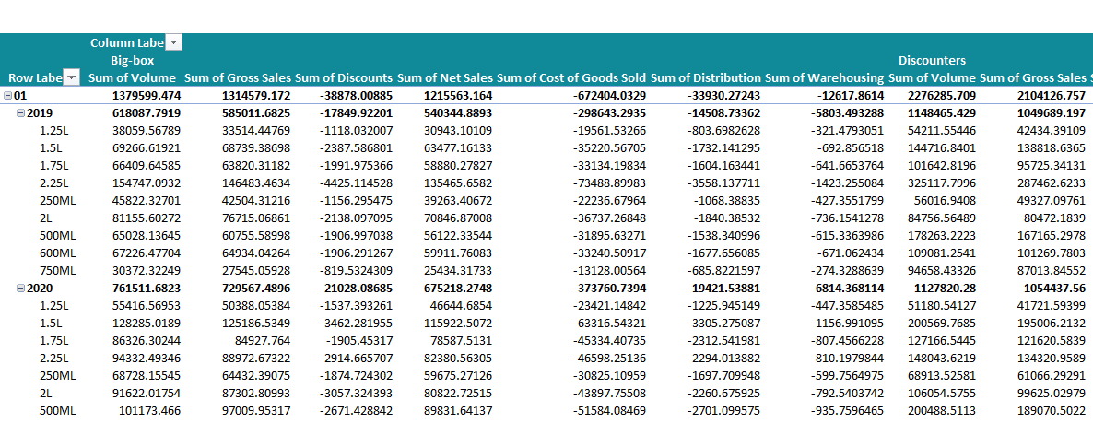
Pivot financials

Slide 4
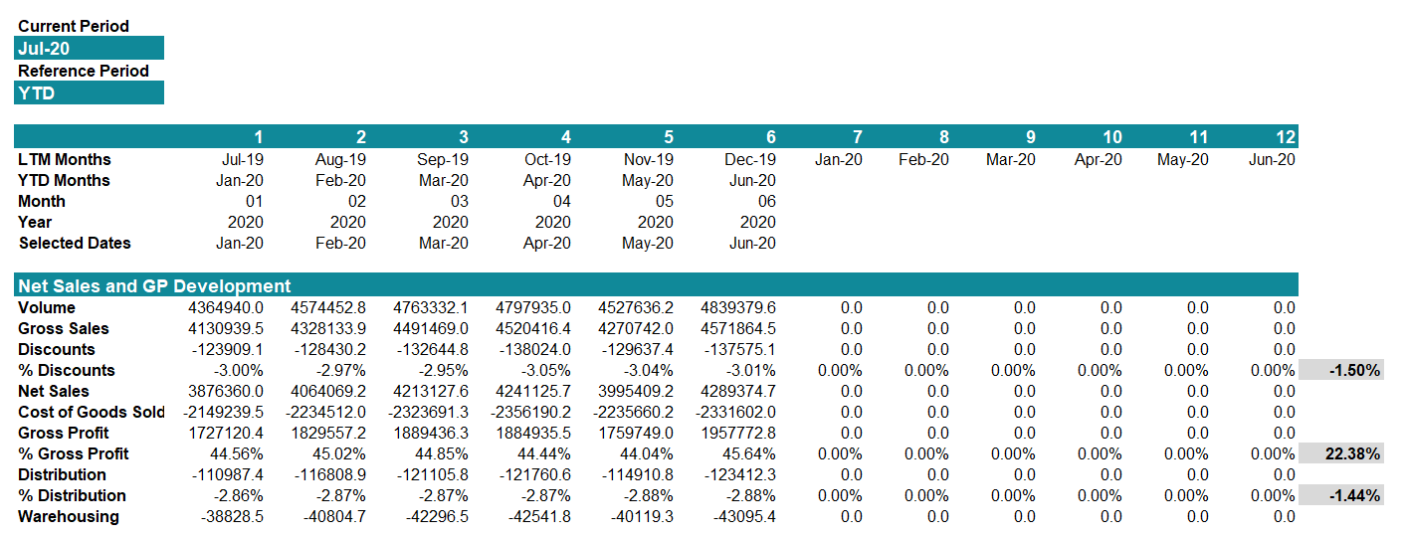
Net Sales and GP% Development

Slide 5
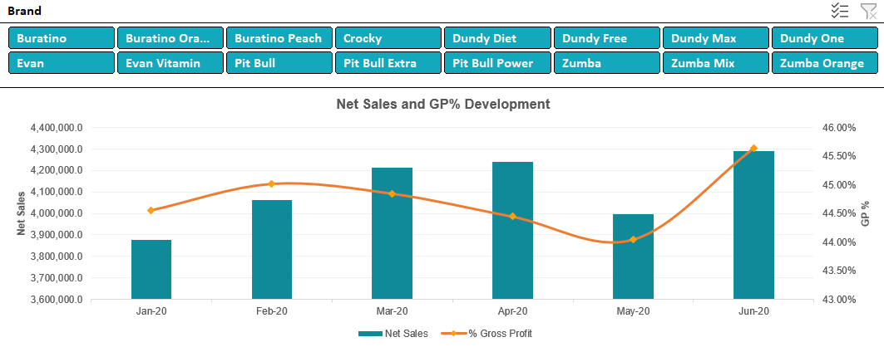
Net Sales and GP% Development

Slide 6
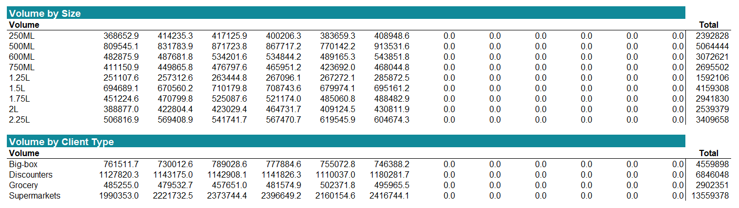
Volume by Size and Client Type

Slide 7
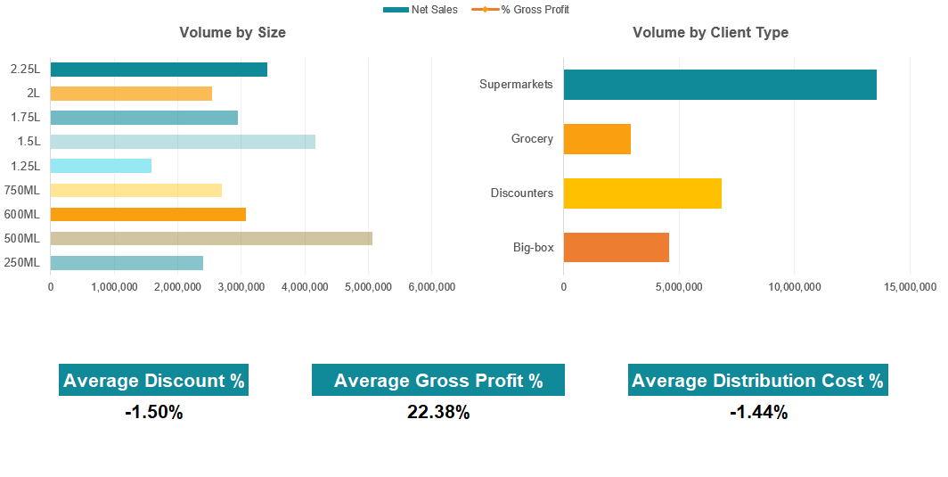
Volume by Size and Client Type

